Slide 1
Attendance of Places of Worship
Press F5
Visions of multilevel models of NLSY-97 data
click here to begin

Slide 2
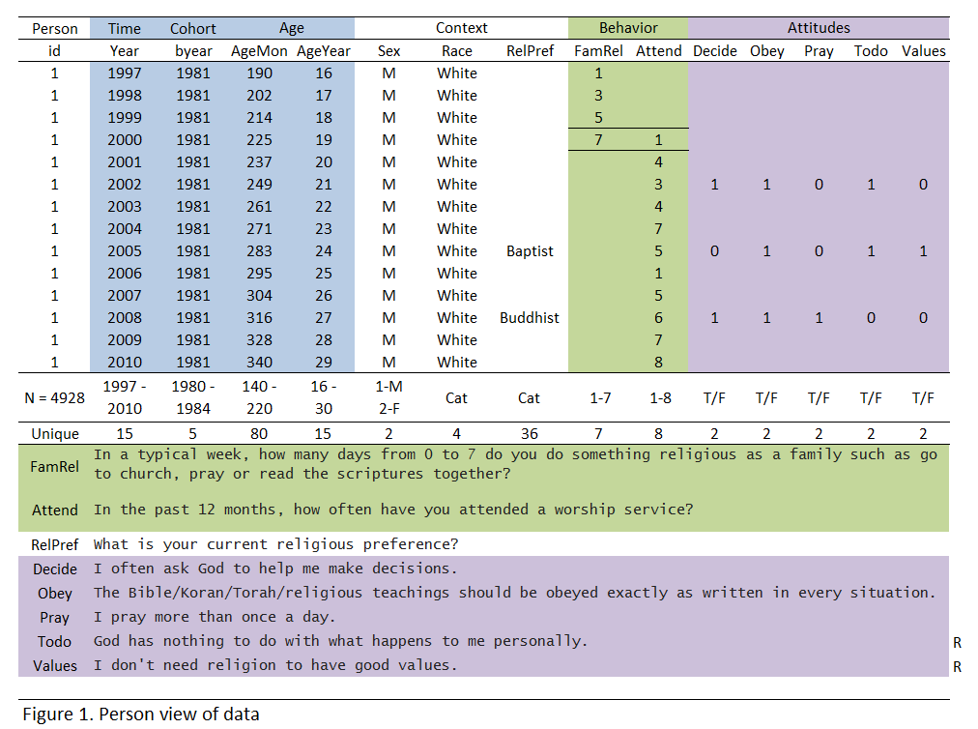
NLSY97 Religiosity 3 level model
Y – worship attendance (1-8)
YEAR– years since 2000, first year of observing religiosity
AGE– age in months, at the time of the interview
C(lass) – class assignment proportions from trajectory mixture
Click to model
i - time

Slide 3
NLSY97 Religiosity 3 level model
Y – worship attendance (1-8)
YEAR– years since 2000, first year of observing religiosity
AGE– age in months, at the time of the interview
C(lass) – class assignment proportions from trajectory mixture
i - time
0
1
2
3
4
5
6
7
8
9
10
11
12

Slide 4
NLSY97 Religiosity 3 level model
Y – worship attendance (1-8)
YEAR– years since 2000, first year of observing religiosity
AGE– age in months, at the time of the interview
C(lass) – class assignment proportions from trajectory mixture
i - time
0
1
2
3
4
5
6
7
8
9
10
11
12

Slide 5
NLSY97 Religiosity 3 level model
Y – worship attendance (1-8)
YEAR– years since 2000, first year of observing religiosity
AGE– age in months, at the time of the interview
C(lass) – class assignment proportions from trajectory mixture
i - time
0
1
2
3
4
5
6
7
8
9
10
11
12

Slide 6
NLSY97 Religiosity 3 level model
Y – worship attendance (1-8)
YEAR– years since 2000, first year of observing religiosity
AGE– age in months, at the time of the interview
C(lass) – class assignment proportions from trajectory mixture
j - person
i - time
0
1
2
3
4
5
6
7
8
9
10
11
12

Slide 7
NLSY97 Religiosity 3 level model
Y – worship attendance (1-8)
YEAR– years since 2000, first year of observing religiosity
AGE– age in months, at the time of the interview
C(lass) – class assignment proportions from trajectory mixture
j - person
i - time
0
1
2
3
4
5
6
7
8
9
10
11
12

Slide 8
NLSY97 Religiosity 3 level model
Y – worship attendance (1-8)
YEAR– years since 2000, first year of observing religiosity
AGE– age in months, at the time of the interview
C(lass) – class assignment proportions from trajectory mixture
j - person
i - time
0
1
2
3
4
5
6
7
8
9
10
11
12

Slide 9
NLSY97 Religiosity 3 level model
Y – worship attendance (1-8)
YEAR– years since 2000, first year of observing religiosity
AGE– age in months, at the time of the interview
C(lass) – class assignment proportions from trajectory mixture
j - person
i - time
0
1
2
3
4
5
6
7
8
9
10
11
12

Slide 10
NLSY97 Religiosity 3 level model
Y – worship attendance (1-8)
YEAR– years since 2000, first year of observing religiosity
AGE– age in months, at the time of the interview
C(lass) – class assignment proportions from trajectory mixture
k - class
j - person
i - time
0
1
2
3
4
5
6
7
8
9
10
11
12

Slide 11
NLSY97 Religiosity 3 level model
Y – worship attendance (1-8)
YEAR– years since 2000, first year of observing religiosity
AGE– age in months, at the time of the interview
C(lass) – class assignment proportions from trajectory mixture
k - class
j - person
i - time
0
1
2
3
4
5
6
7
8
9
10
11
12

Slide 12
NLSY97 Religiosity 3 level model
Y – worship attendance (1-8)
YEAR– years since 2000, first year of observing religiosity
AGE– age in months, at the time of the interview
C(lass) – class assignment proportions from trajectory mixture
k - class
j - person
i - time
0
1
2
3
4
5
6
7
8
9
10
11
12

Slide 13
i - time
0
1
2
3
4
5
6
7
8
9
10
11
12
Notes:
Null Model

Slide 14
i - time
0
1
2
3
4
5
6
7
8
9
10
11
12

Slide 15
i - time
0
1
2
3
4
5
6
7
8
9
10
11
12

Slide 16
j - person
i - time
0
1
2
3
4
5
6
7
8
9
10
11
12

Slide 17
j - person
i - time
0
1
2
3
4
5
6
7
8
9
10
11
12

Slide 18
j - person
i - time
0
1
2
3
4
5
6
7
8
9
10
11
12

Slide 19
j - person
i - time
0
1
2
3
4
5
6
7
8
9
10
11
12

Slide 20
k - class
j - person
i - time
0
1
2
3
4
5
6
7
8
9
10
11
12

Slide 21
k - class
j - person
i - time
0
1
2
3
4
5
6
7
8
9
10
11
12

Slide 22
k - class
j - person
i - time
0
1
2
3
4
5
6
7
8
9
10
11
12

